Slide 1
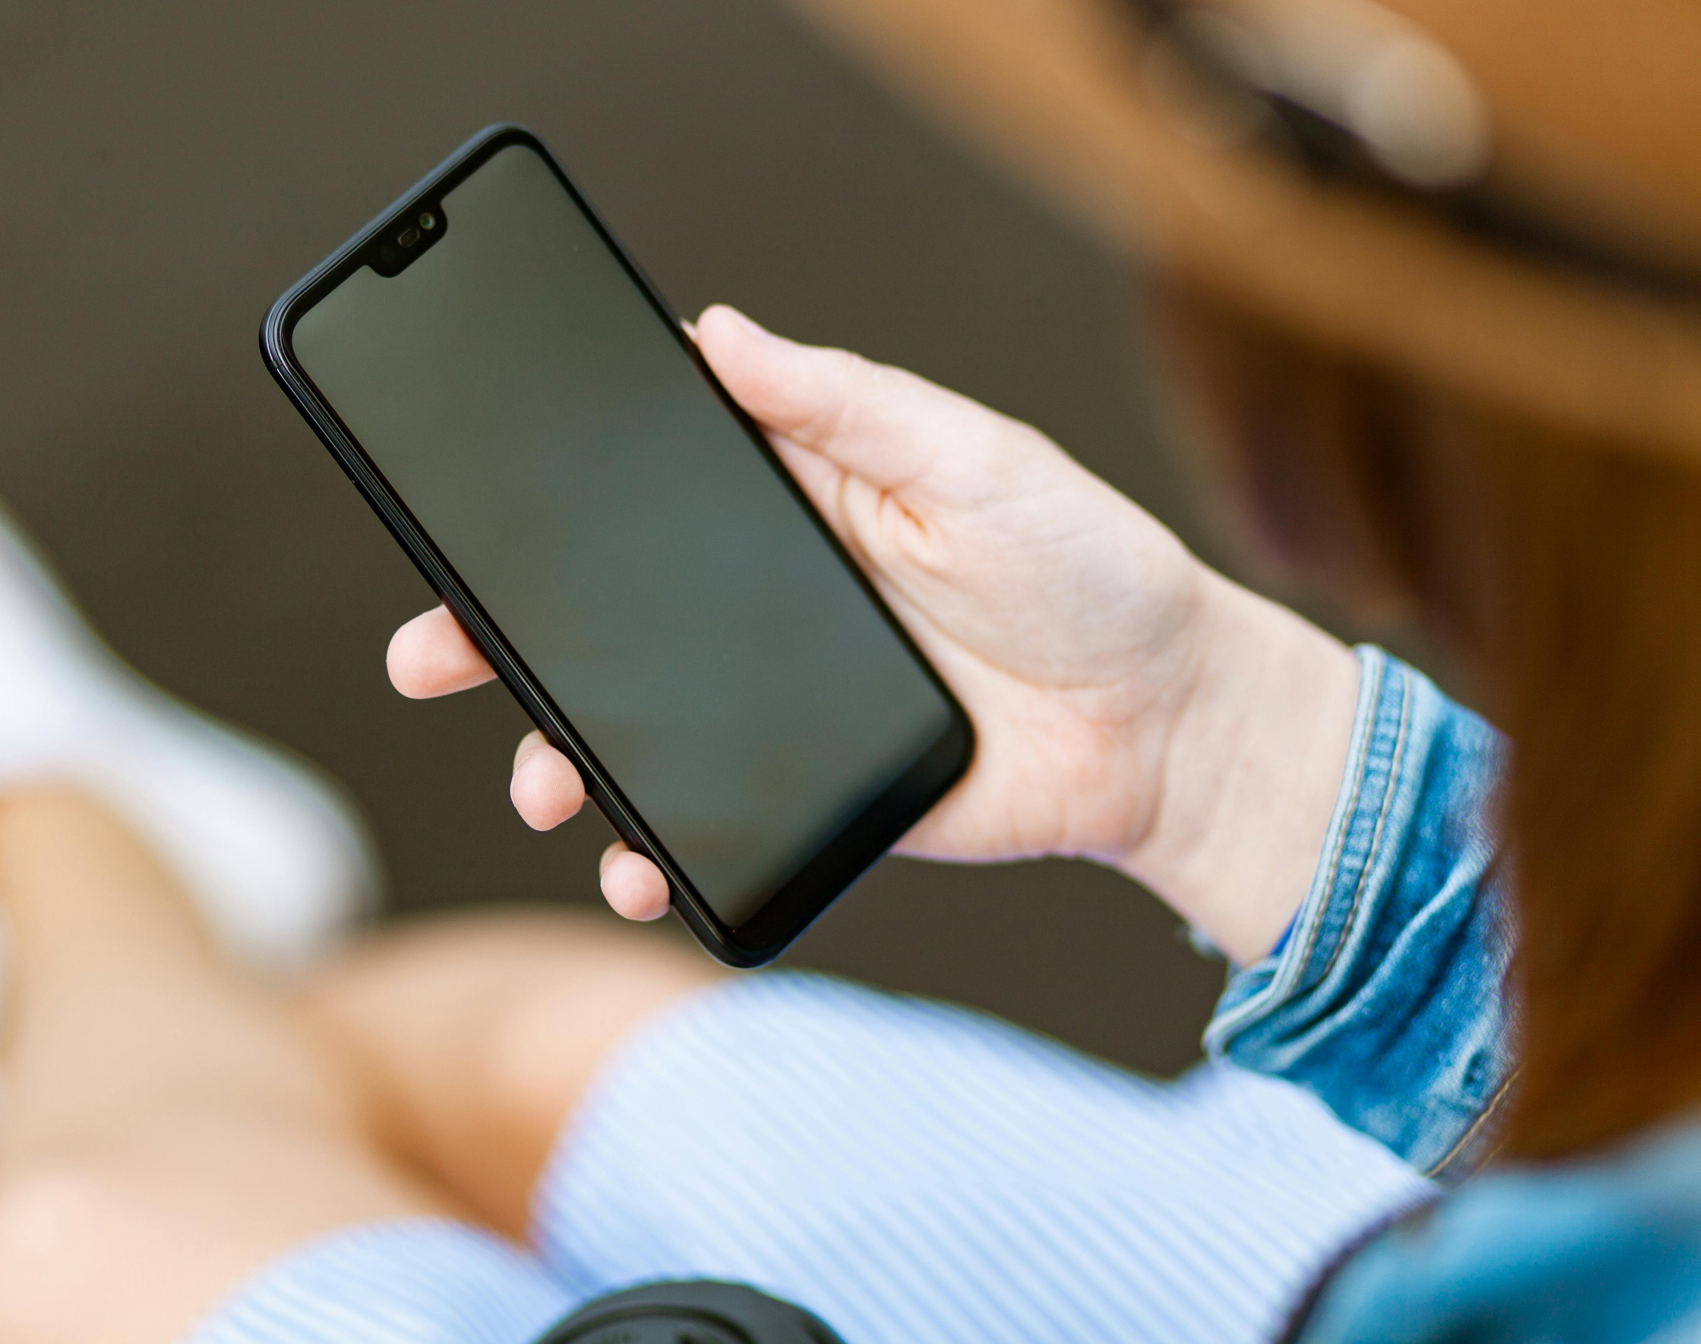
Smartphone-Based Human Activity Recognition Using Inertial
Sensors
Tomas Pastore Godoy, Mateo Saettone, and Ethan Thompson
CIS4930 – Wireless and Mobile Computing
April 22nd, 2026

Slide 2
Overview
Context and Background
Dataset Overview
System Overview
Experimental Results
Limitations and Future Work

Slide 3
Context and Background
Our idea: make an activity tracking/sensing app that detects user movement
Activity recognition has real applications in health monitoring, fitness tracking, and elderly care
Smartphones are already widely available, so a purely software-based solution requires no extra hardware
Practical problem with meaningful impact

Slide 4

Why Mobile?
Phone carrying is the norm for most adults, many fitness devices have some form of mobile connection already
Smart watches and fitness bands (Fitbit)
Alternatives present issues such as infrastructure costs and privacy concerns
Less likely to hallucinate movement

Slide 5
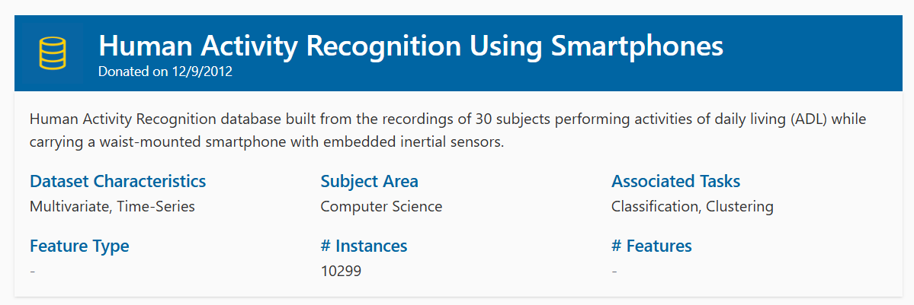
Dataset Overview
Consists of data collected from 30 volunteers aged 19 - 48
Each participants performed the following activities:
Walking
Walking up and down stairs
Sitting
Standing
Laying down
Data obtained via accelerometer and gyroscope of Samsung Galaxy S II worn on waist
70/30 split between training data and test data

Slide 6
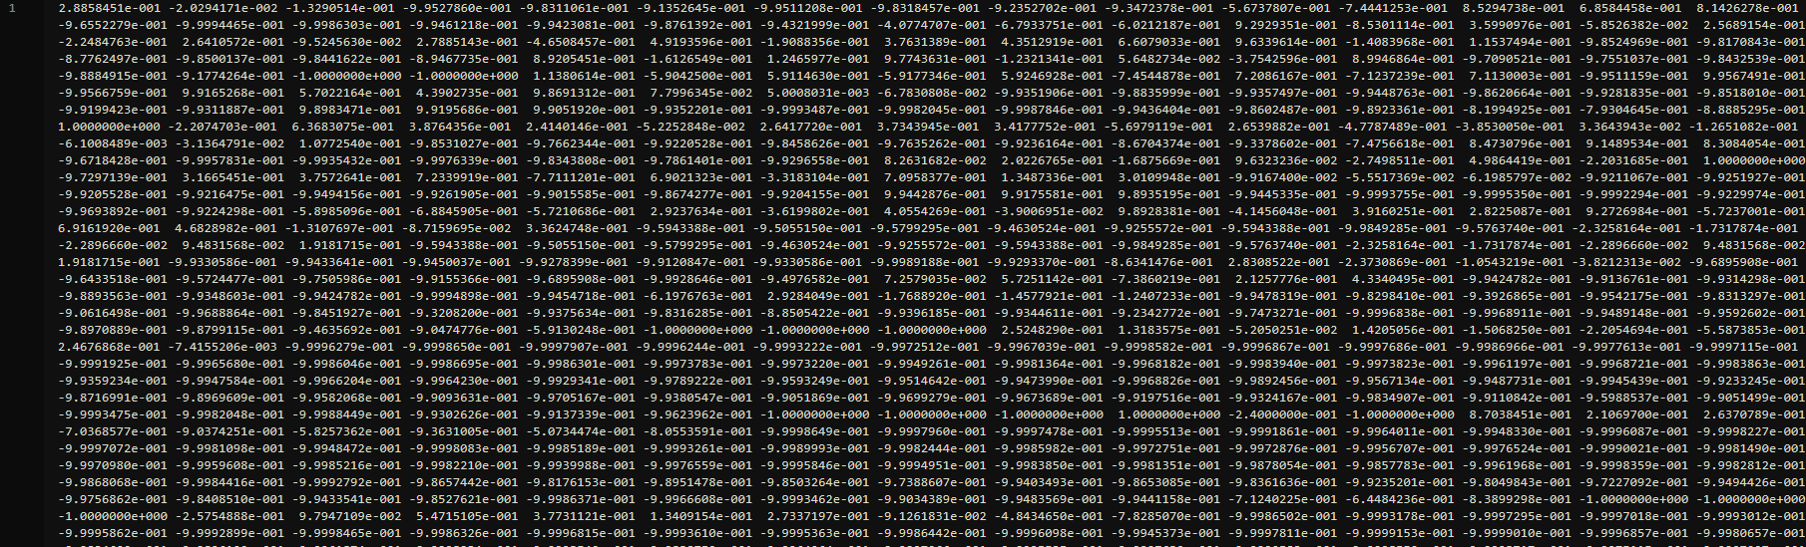
Dataset Overview
Includes time information for body acceleration, gravity acceleration, and gyro information for X, Y, and Z axes
Magnitude of each is also calculated
Sensors: 3-axis accel + 3-axis gyro at 50 Hz
Windows: 2.56 s, 50% overlap → 128 samples/window
Comes in two flavors: raw inertial signals and a 561-feature engineered table
Train/test data is split up into dataset, activity labels, subject number, and inertial signals for gyro and acceleration data

Slide 7
Our System
Model 1: Random Forest
Model 2: 1D CNN
Classical ML baseline on the 561 engineered features
200 trees, bootstrap + Gini split, trained in seconds
Used for comparison – strong but plateaus below the CNN
Test accuracy: 85.3%
1D CNN over raw 128×9 inertial windows
Conv(64)→Pool→Conv(64)→Pool→Conv(64)→GAP→Dense(100)→Softmax
~120k parameters, exported to ONNX (≈170 KB)
Test accuracy: 90.5%

Slide 8
Training Pipeline
Raw data from UCI dataset (acceleration and gyro)
Preprocessing (window, filtering, normalization, splitting)
Feature extraction (time and frequency, raw data window for CNN model)
Model training
Exporting results (model.json + TF.js, ONNX Web)

Slide 9
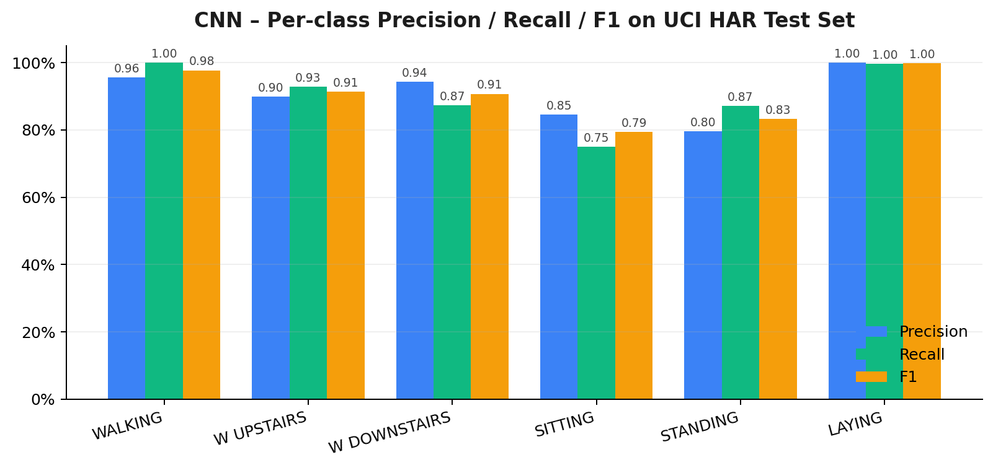
Experimental Results
1D CNN – 90.5% test accuracy on held-out subjects (proposal target ≥ 90%)
Random Forest baseline – 85.3% test accuracy
CNN advantage concentrated on walking-type classes
WALKING F1 0.977 (RF 0.848)
WALK UPSTAIRS F1 0.913 (RF 0.824)
WALK DOWNSTAIRS F1 0.907 (RF 0.876)
Both models near-perfect on LAYING (F1 ≈ 1.00)
Main confusion: SITTING ↔ STANDING for both models (static + similar posture)

Slide 10
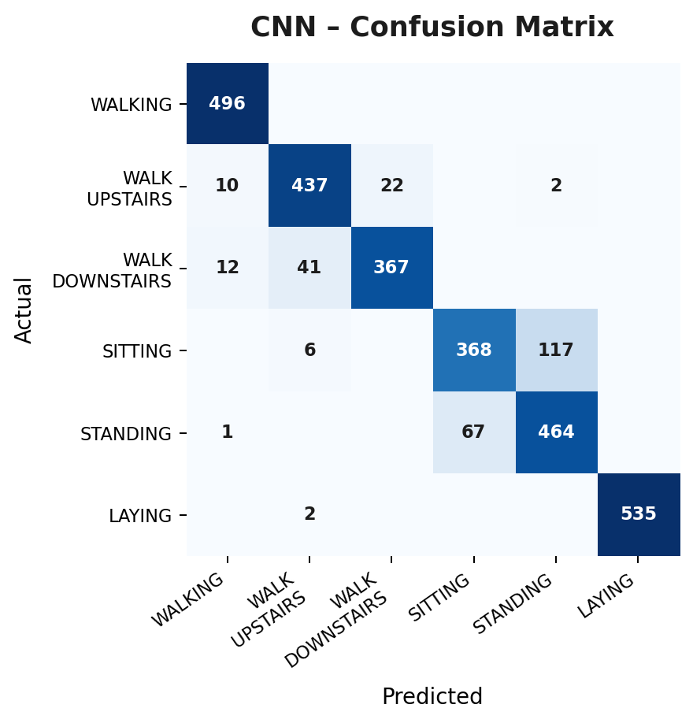
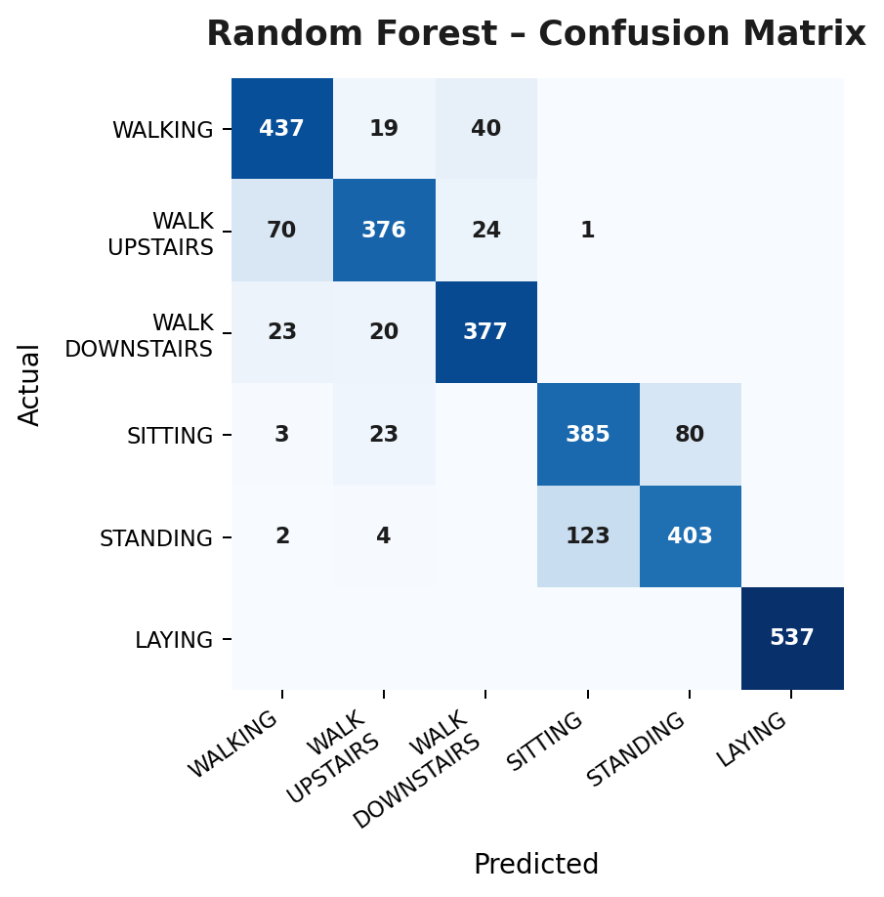
Experimental Results – Confusion Matrices
Rows = true label, columns = predicted. Deeper blue = higher share. CNN collapses the stairs / walking confusion; both models split SITTING and STANDING.

Slide 11
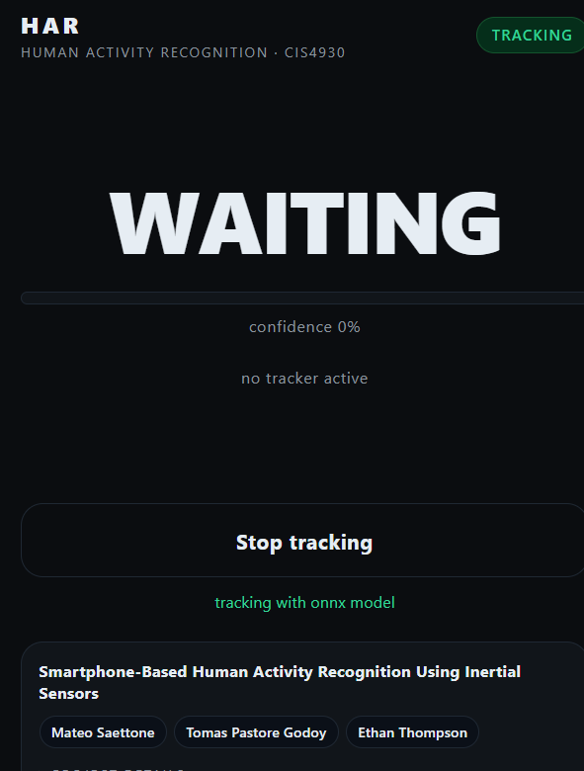
Final Product
Final project is publicly available as a web app
https://har-demo-cis4930.vercel.app/
Uses our trained model to predict the current movement of the user based on model classes by tracking motion and acceleration of user's phone
Detects all types of movement with fair accuracy

Slide 12
How It Works – Tech Stack & Data Flow
Data flow (end-to-end, in-browser)
Phone opens har-demo-cis4930.vercel.app – a Progressive Web App loads
iOS/Android DeviceMotion API streams accel + gyro at 50–100 Hz
Sliding 2.56 s window (128 samples × 9 channels, matches UCI HAR)
ONNX Runtime Web runs the 1D CNN on-device via WebAssembly – no server
Every ~0.32 s a prediction is published to Supabase Realtime Broadcast
Any other device on the same URL auto-joins as a viewer and mirrors the label
Tech stack
Frontend: vanilla HTML + ES modules (no framework, no build step)
Inference: ONNX Runtime Web (WASM backend) – model is ~170 KB
Realtime: Supabase Broadcast – ephemeral pub/sub, no tables or RLS
Hosting: Vercel static deployment, auto-redeployed on every git push
Training: Python · TensorFlow / Keras · tf2onnx · scikit-learn (RF baseline)
Source: github.com/MateoSaettone/Har-Demo

Slide 13
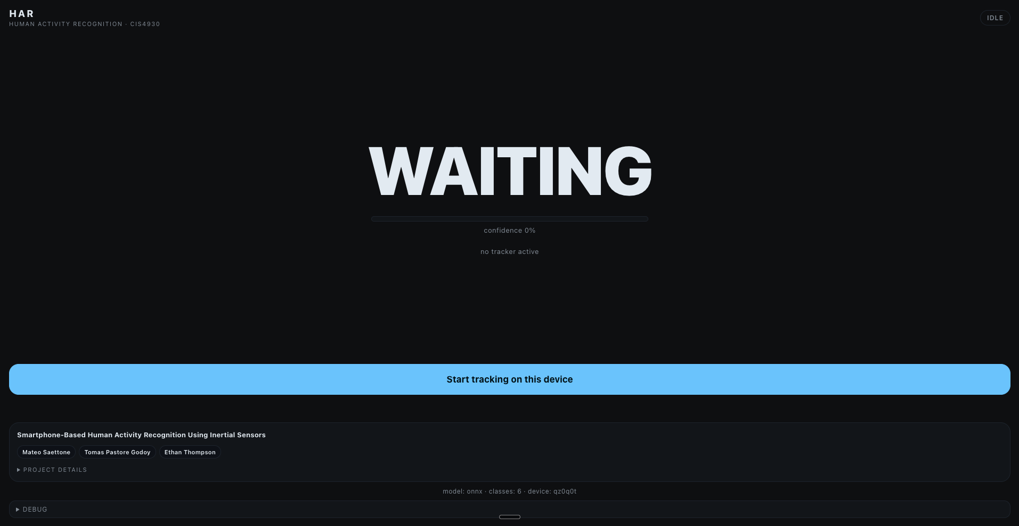
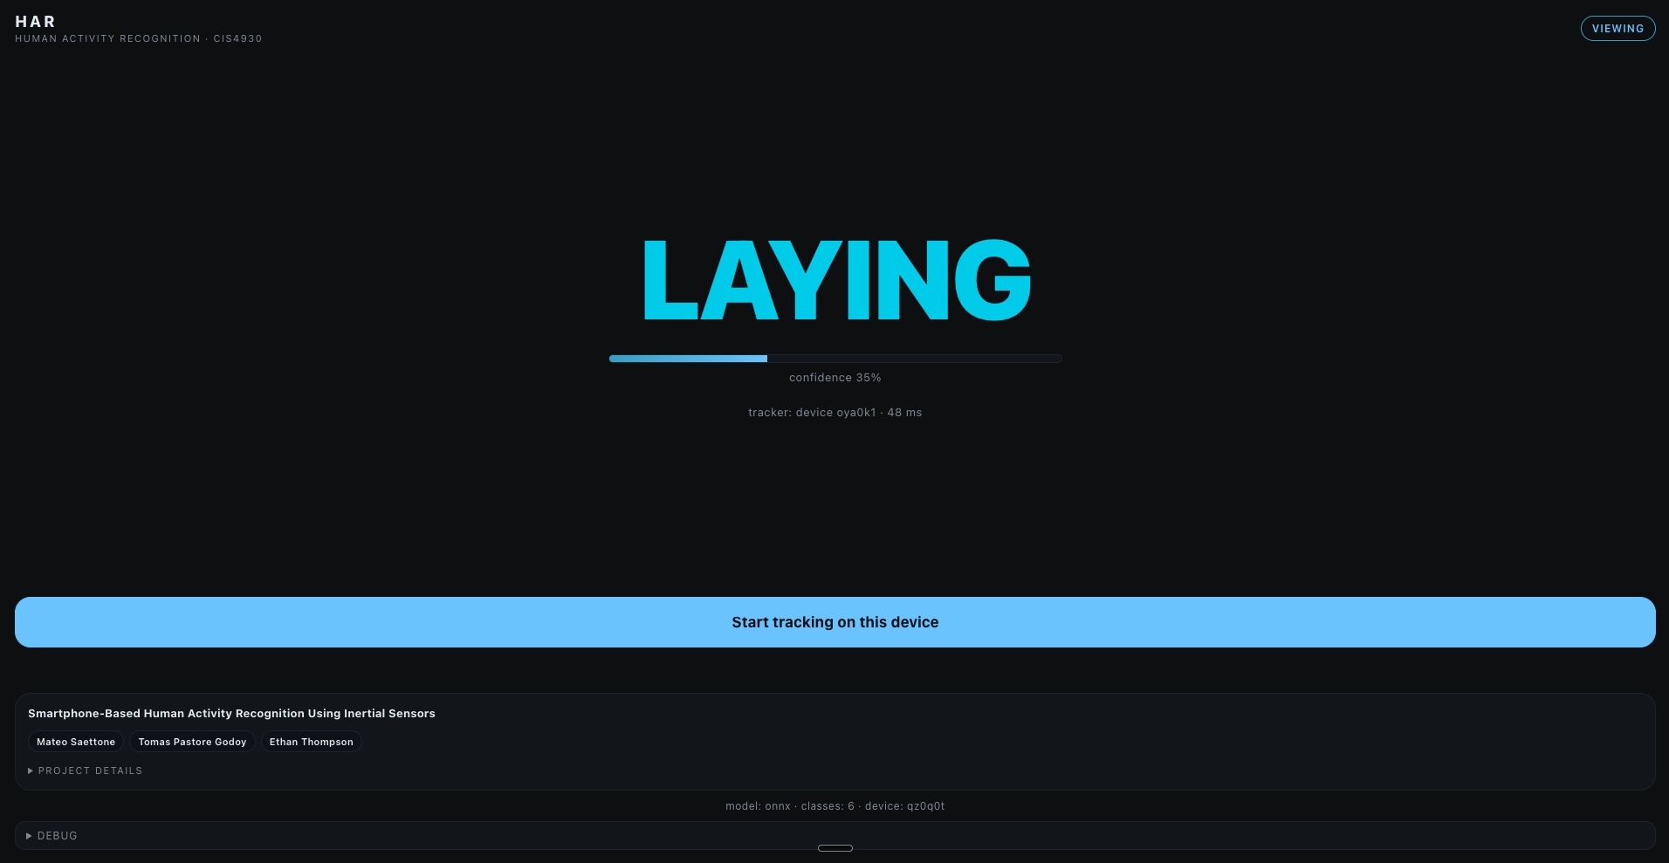
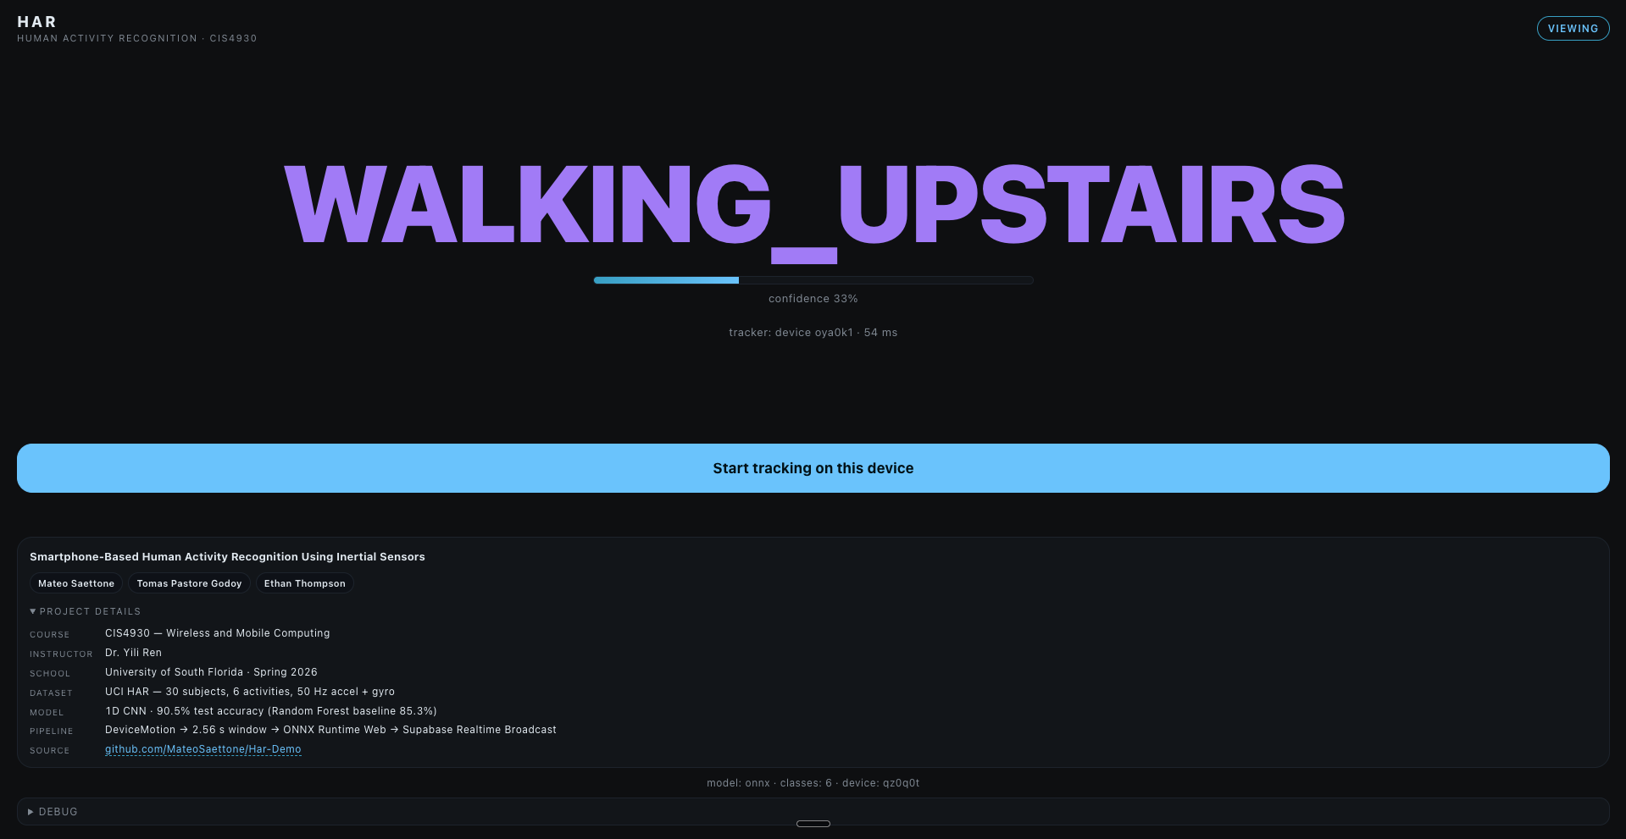
Live Web App – UI Walkthrough
Idle state – awaiting a tracker
Live prediction streamed to a viewer
Project details expanded on the viewer
Single URL, two auto-detected roles.
A device becomes a tracker the moment it taps Start tracking; every other device on the URL automatically becomes a viewer and mirrors the live label in real time — no pairing, no codes, no second app. The huge centered label is sized for readability from across a room when the phone is mirrored to a projector.
On-screen chrome stays minimal: team chips, expandable Project Details with course / instructor / school / dataset / model / pipeline / repo, a Debug panel exposing the raw 9-channel sensor stream and per-class probabilities, and a status pill (idle · viewing · tracking) in the top-right corner.

Slide 14
Limitations and Future Work
Domain shift: UCI HAR was collected with the phone clipped to the waist
Our users carry the phone in a pocket or hand – axes and gravity differ
Result: 90.5% on UCI test ≠ 90.5% on a real iPhone in a pocket
SITTING ↔ STANDING confusion – both are static, similar gravity signature
Sensor sampling variability – iOS/Android fire DeviceMotion at 50–100 Hz
We resample to 50 Hz to match training, but axis conventions still differ
Single-subject bias – dataset covers 30 subjects, mostly young adults
Future work
On-device data collection mode (CSV or Supabase upload) to retrain on real phones
Orientation-invariant features (signal magnitudes, rotation to principal axis)
Fine-tuning or few-shot calibration per user at first launch
Extend to smartwatches for continuous wear without the pocket assumption

Slide 15
Conclusion
Delivered a working smartphone HAR system end-to-end – data → model → live web demo
Trained two models on UCI HAR and evaluated on held-out subjects
Random Forest baseline – 85.3% accuracy
1D CNN – 90.5% accuracy, meeting the proposal target
Shipped as a PWA at har-demo-cis4930.vercel.app
ONNX Runtime Web runs inference in the browser – no backend, no install
Supabase Realtime Broadcast lets a projector view mirror the phone in a pocket
Honest limitation: transferring UCI HAR to real-world pocket use degrades accuracy
Next step: collect labeled data on our own phones and retrain for the target domain

Slide 16
Thank You
Questions?
Tomas Pastore Godoy · Mateo Saettone · Ethan Thompson
CIS4930 – Wireless and Mobile Computing
Live demo: har-demo-cis4930.vercel.app
Source: github.com/MateoSaettone/Har-Demo

